Slide 1

Assigning Variables
Unit 1.1 · Computational thinking and programming
A slide-by-slide explanation with all the activities
Notes:
Welcome. In this lesson we learn what a variable is, how to give it a value with 'set', and how a value can change. We follow a ladybug, a birthday card, and Marcus's favourite vegetable, then finish with three activities.

Slide 2
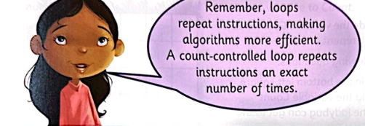
Recap: Count-Controlled Loops
Why use loops?
Repeat instructions
Fewer lines to write
More efficient algorithms
A number tells the loop how many times to run
Count-controlled loop
Repeats the instructions an exact number of times. The number of repeats is stored in a variable.
Notes:
A loop repeats instructions, which makes an algorithm shorter and more efficient. A count-controlled loop repeats an exact number of times. The question is: where do we store that number? The answer is a variable.

Slide 3
The Ladybug Algorithm
1 Set Count to 2
2 REPEAT Count
3 Move forward
4 Turn right
5 Move forward
6 Turn left
Line 1
Stores the number 2 in the variable Count.
1
Line 2
REPEAT Count means: run the indented lines Count times.
2
Lines 3–6
Forward, right, forward, left: one step up and one step right.
The word Count in line 1 is a variable.
3
Notes:
Line 1 sets Count to 2. Line 2 says REPEAT Count, so the indented lines run Count times. Inside the loop the ladybug moves forward, turns right, moves forward, and turns left. That is one step up and one step right, so after two repeats it has climbed two steps.

Slide 4
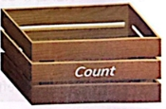
What Is a Variable?
A variable stores data for the program to use later.
Here, Count stores how many times the loop will repeat.
Meaningful names
Good: Count, Age, Name
Unclear: x, thing
Variable = a labelled box
A good name tells us what data is inside the box.
Notes:
Imagine a variable as a labelled box. The label is the variable's name, and inside the box is the value. Count is a meaningful name because it tells us what is stored: how many times the loop repeats. Always choose names that describe the data.

Slide 5
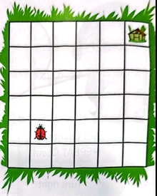
Questions 1 & 2
PAIR DISCUSSION
How it is done
Work in pairs. Trace the ladybug on the grid. One loop repeat = 1 square up + 1 square right.
Q1 What should Count hold from the bottom-left square?
Answer: 5, because the hotel is 5 diagonal steps away.
Q2 What value if the ladybug moves one square up and right?
Answer: 4, because it needs one step fewer.
Notes:
Pair discussion. Each loop repeat makes the ladybug go forward, turn right, forward, turn left, so it moves one square up and one square right. The bug hotel is in the top-right corner. From the bottom-left, five diagonal steps are needed, so Count = 5. If the ladybug starts one square up and right, it needs one step less, so Count = 4.

Slide 6
Assigning a Value
set Count to 5
The value goes into the variable
Assigning = putting a value into the box.
set Count to 5 puts the number 5 into the box called Count.
REPEAT Count will now run 5 times.
5
Value
Variable
Notes:
Assigning means putting a value into the variable. 'set Count to 5' is like putting the number 5 into the box labelled Count. Now the loop will repeat five times.

Slide 7
Changing the Value
set Count to 5
set Count to 4
5
4
5
old value
A variable can only hold ONE item of data. The new value replaces the old one, so the loop now repeats 4 times.
Notes:
If we move the ladybug closer to the hotel, we change the number we give to Count. Now 4 is stored in Count. The 5 is no longer in the box, because a variable can only hold one item of data at a time. The new value replaces the old one.

Slide 8
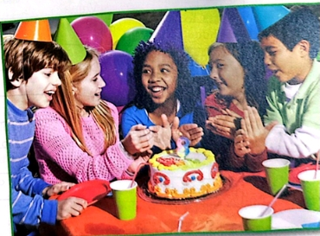
Values That Can Change
Values
The numbers and words we use in our algorithms. They often change.
Text
“Miah”
Number
8
Symbol
!
Same card, different party: Mike is 9, so only the name and age values change.
Happy Birthday Miah! You are 8.
Notes:
Values are the numbers and words we use in algorithms. They can be text, numbers or symbols. Think of an electronic birthday card: it says Happy Birthday, your name, and how old you are. The name and age change depending on whose birthday it is. For Miah the values are 'Miah' and 8; for Mike on the next page they are 'Mike' and 9.

Slide 9
The Birthday Card Algorithm
1 set Name to Mike
2 set Age to 9
3 say Happy Birthday, Name
4 say You are, Age
Lines 1–2
Assign the values to the variables.
Lines 3–4
say displays the values stored in them.
Output
Happy Birthday, Mike
You are, 9
Name = Mike
Age = 9
Two variables, two boxes
Notes:
To assign Age to 9 we say 'set Age to 9'. In the algorithm for Mike, lines 1 and 2 assign the variables Name and Age. Lines 3 and 4 use the variable names to say the message. Because we refer to the names, we can reuse the same program for any child by changing only lines 1 and 2.

Slide 10

Birthday Parties
UNPLUGGED ACTIVITY 1
How it is done
Copy the table.
Read the name and age in A, B, C.
Fill in the two variables.
Write the birthday message.
You will need: pen and paper
Child | A | B | C
Value for Name | Katy | Juan | Meena
Value for Age | 9 | 10 | 9
Happy birthday message | Happy Birthday, Katy! You are 9. | Happy Birthday, Juan! You are 10. | Happy Birthday, Meena! You are 9.
Notes:
Unplugged activity 1 needs only a pen and paper. Students copy the table, look at pictures A, B and C, read each child's name and age from the picture, write them as the values of the Name and Age variables, and then write the message the birthday algorithm would output. Answers: A is Katy, 9. B is Juan, 10. C is Meena, 9 (the banner in picture C is small, so check it with the class).

Slide 11
Challenge Question
QUESTION 4
If you wanted to add who the birthday card was from, why would you use a variable?
Name
Mike
Age
9
Answer
The sender is different each time. A variable lets one program work for any sender: change the value once and use its name anywhere.
From
Sofia (example)
One variable per changing value
Notes:
Question 4: if you wanted to add who the card was from, why would you use a variable? Because the sender changes every time. A variable such as From lets one program work for any sender: we only change the value once, and the name can be used wherever it is needed.

Slide 12

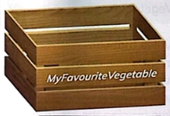
Marcus's Shopping Program
The idea
Marcus stores his favourite items in variables, so shopping is quicker each time.
Variable name
MyFavouriteVegetable tells us exactly what is inside.
Notes:
Marcus is creating a program for buying his favourite things from the supermarket. He sets his favourite items once, which makes shopping quicker. He uses variables to store them. For his favourite vegetable he names the variable MyFavouriteVegetable, a meaningful name.

Slide 13
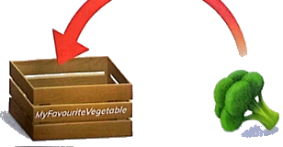
Assigning a Text Value
set MyFavouriteVegetable to broccoli
set = the command
MyFavouriteVegetable = the variable
broccoli = the value
The value broccoli goes into the box called MyFavouriteVegetable. Values can be words as well as numbers.
Notes:
Marcus wants the program to store his favourite vegetable: broccoli. He assigns the variable MyFavouriteVegetable to the value 'broccoli'. The command set means 'put this value in this variable'. The value here is text, not a number.

Slide 14
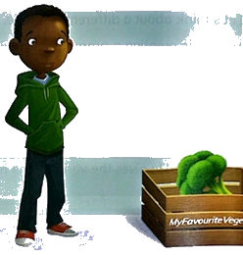
Displaying a Value with say
1 set MyFavouriteVegetable to broccoli
2 say MyFavouriteVegetable
Line 2
say looks inside the variable and shows its value.
Output
broccoli
Notes:
To display what is inside a variable we use say followed by the variable name. The output is the value, broccoli, not the name of the variable. Marcus's complete algorithm first assigns the value and then displays it.

Slide 15


Values Are Temporary
Marcus
Sofia
set MyFavouriteVegetable to broccoli
say MyFavouriteVegetable
set MyFavouriteVegetable to carrot
say MyFavouriteVegetable
Output: broccoli
Output: carrot
Temporary means the value is not kept forever. Same program, different value for each user.
Notes:
A variable holds a temporary value that can change; it is not kept forever. Not everyone has the same favourite vegetable, so depending on who uses the program, a different value is stored. Marcus gets broccoli; Sofia gets carrot. The algorithm has the same shape, only the value changes.

Slide 16
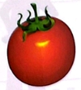
Questions 5 – 7
PRACTICE
Write an algorithm that assigns MyFavouriteVegetable to your own favourite vegetable.
Example: set MyFavouriteVegetable to peas, then say MyFavouriteVegetable
5
Compare your algorithm with your partner's and discuss the differences.
Same structure, different value. That is the point of a variable.
6
Is a tomato a fruit or a vegetable? Choose your names carefully!
What meaningful name would you give Marcus's favourite fruit variable?
Example: MyFavouriteFruit
7
Notes:
Question 5: write an algorithm that assigns MyFavouriteVegetable to your own favourite vegetable, for example peas, and say it. Question 6: compare with your partner. The structure is the same; only the value differs. Question 7: Marcus wants a variable for his favourite fruit, so a meaningful name is MyFavouriteFruit.

Slide 17
Make a Poster
ACTIVITY 2
You will need: a computer or tablet with word-processing software
What is a variable?
Plan: what is a variable? Add the box idea and the words value and name.
1
Open your word processor and add a title.
2
A labelled box that stores a value
Add images, such as a labelled box, and an example like set Count to 4.
3
set Count to 4
Check it, then share it with the class.
4
Notes:
Activity 2 uses a desktop computer, laptop or tablet with word-processing software. The task: create a poster that explains what variables are and how we use them. Plan the content first, build the poster, then check it and share it with the class.

Slide 18

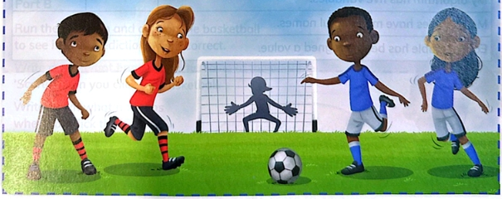
Football: Part A
UNPLUGGED ACTIVITY 3
1 How many different values are on the screen?
5 values: Python, Sprite, 2, 3 and 30:00
2 What do the values represent?
Team names, each score, and time left
3 Which values might change?
The scores and the time remaining
4 Why hold each value in a variable?
We can update and reuse it by its name
Notes:
Unplugged activity 3 needs a pen and paper or a mini whiteboard. Look at the football game. The screen shows different values: numbers and letters. In pairs, answer four questions. 1) There are five values: Python, Sprite, 2, 3 and 30:00. 2) They are the two team names, each team's score and the time remaining. 3) The scores and the time will change. 4) Holding each value in a variable lets the program update it and use it by name.

Slide 19
Football: Part B
UNPLUGGED ACTIVITY 3
1 set Team1Name to Python
2 set Team2Name to Sprite
3 set Team1Score to 0
4 set Team2Score to 0
5 set TimeRemaining to 30:00
How it is done
Work in pairs.
Use Part A answers.
Meaningful names.
One set line per value.
At the start of the match the scores are 0, so we use 0 instead of the 2 and 3 in the picture.
Notes:
Part B: in pairs, write an algorithm that assigns the variables to the values at the start of the match, using the picture and your answers from Part A. At the start the scores would be 0 and 0 and the time 30:00. Variable names should be meaningful. Note: part of this instruction is cut off in the photo, so check the book for the full wording.

Slide 20
Key Takeaways
1
A variable is a labelled box that stores a value.
2
set Name to value puts a value in the box.
3
It holds one value at a time, and the value can change.
4
Choose meaningful names, such as Count or Age.
5
say displays the value inside the variable.
Thank you!
Notes:
Recap: a variable is a labelled box; set gives it a value; it holds one value at a time and the value can change; names should be meaningful; say displays the value.

